Slide 1

Retail Project
Setup environment and Build data warehouse
1st meeting
2022.05.29 by David yang

Slide 2
Agenda
★ What’s the Data analysis Project?
★ Why ETL?
★ Build EDW data marts model.
★ Source to target mapping analysis.
★ Learning how to use SSIS

Slide 3
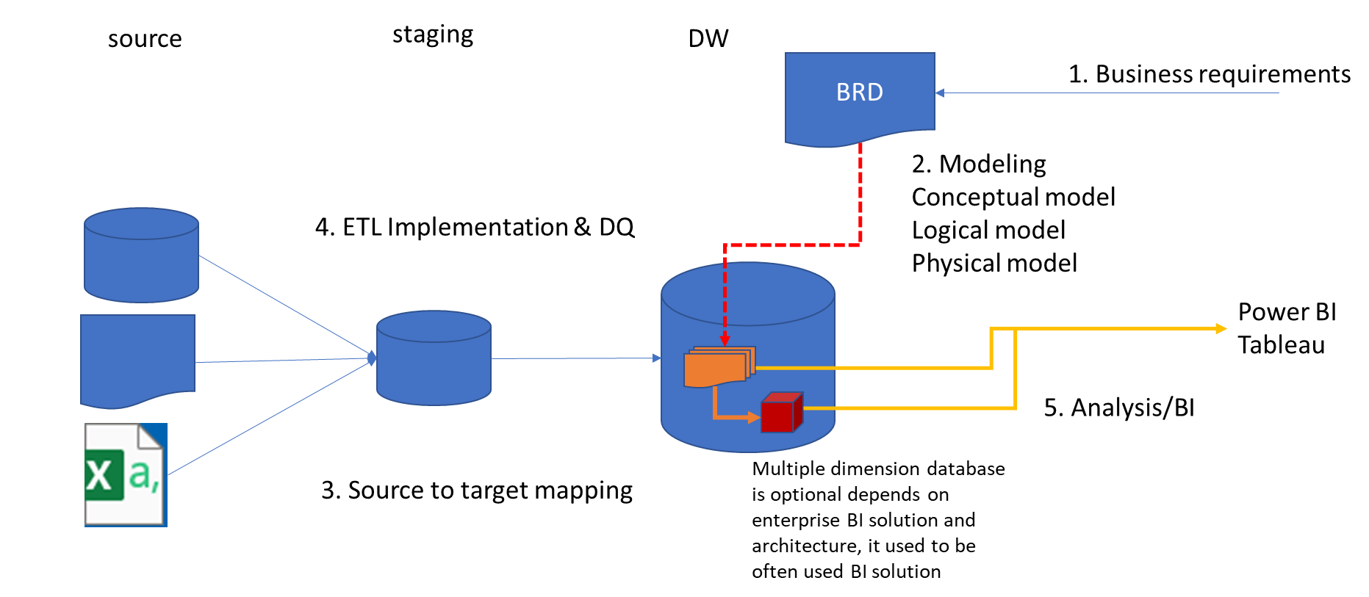
What’s the Data analysis Project?
It is the use of past and current project data to enable effective decisions on project delivery.
It includes: Descriptive analytics presenting data in the most effective format
Predictive analytics using past data to predict future performance

Slide 4
Why ETL?
★ better information leads to better decisions, focus on the subject.
★ More effective, more intelligent, more safe Data Management over time.

Slide 5
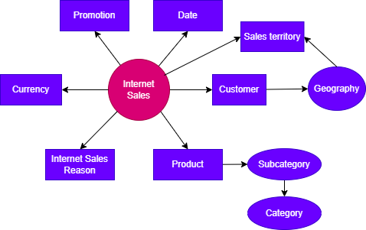
Analyze EDW datamarts model
★ Build the Conceptual Model according to different dimensions with Draw IO integration

Slide 6
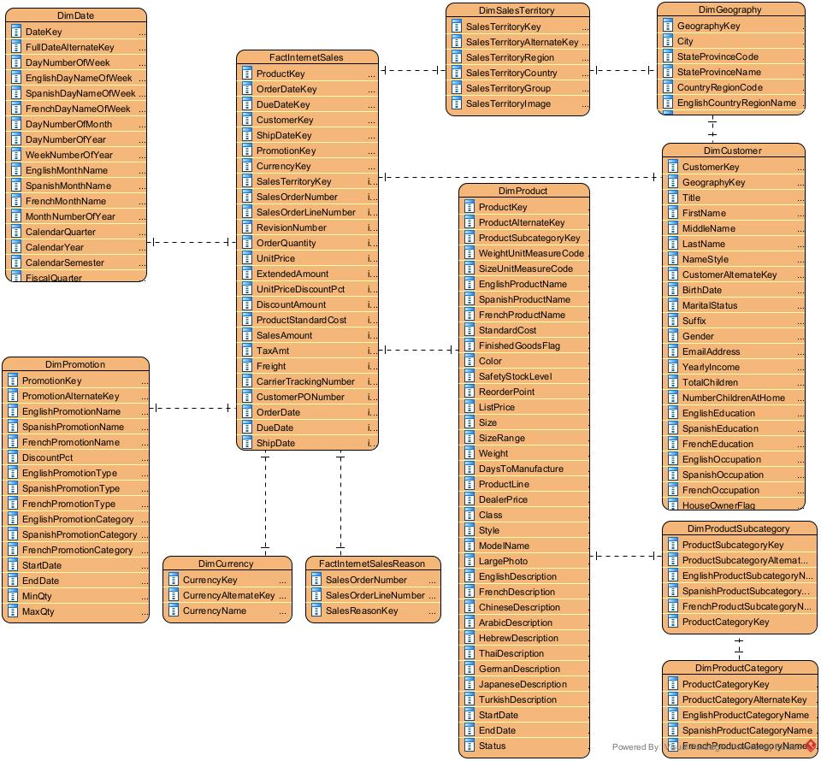
Analyze EDW datamarts model
★ Build the Logical Model with Visual Paradigm.

Slide 7
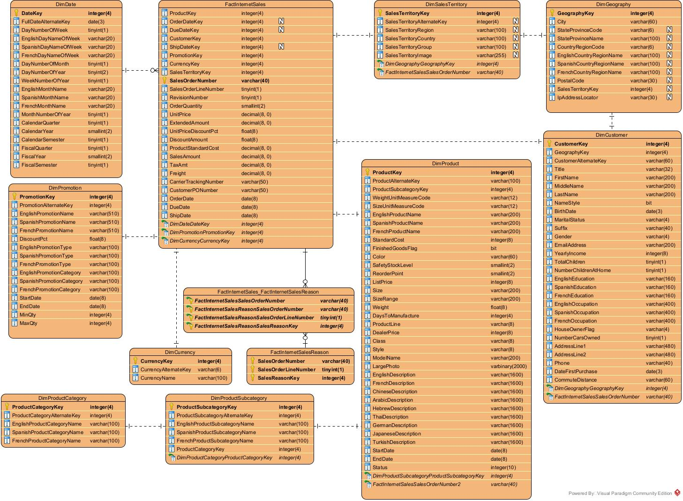
Analyze EDW datamarts model
★ Build the Physical Model with Visual Paradigm.

Slide 8
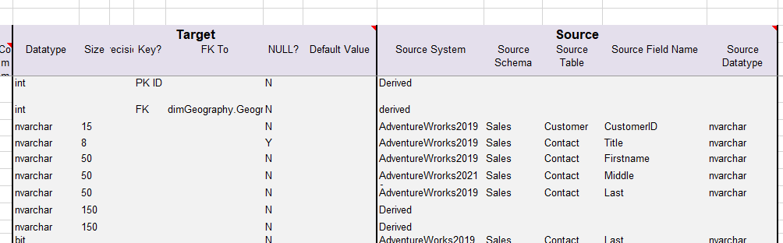

Source to target mapping analysis
★ Create the database and identify relationships between the source tables and the target tables.

Slide 9
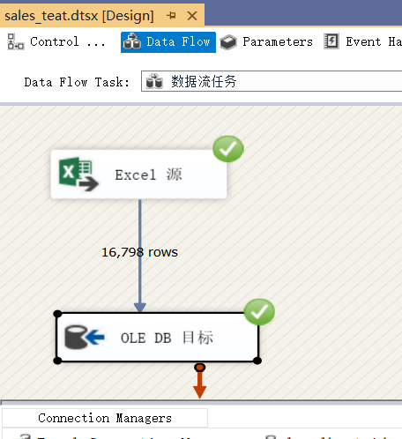
Learning how to use SSIS
Repeat the SSIS Demo and try to ETL the DimCustormer table by SSIS(Sql Server Integration Services) and SSMS(SQL Server Management Studio).

Slide 10
Retail Project
ETL Implementation
2ND meeting
2022.06.05 by David yang

Slide 11
Agenda
★ Data Preparation
★ ETL by SSMS and SSIS
★ ETL basically by SSIS

Slide 12
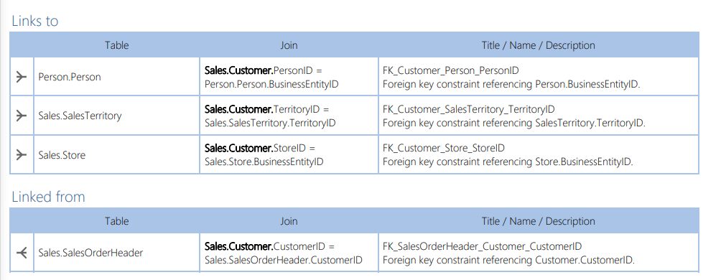
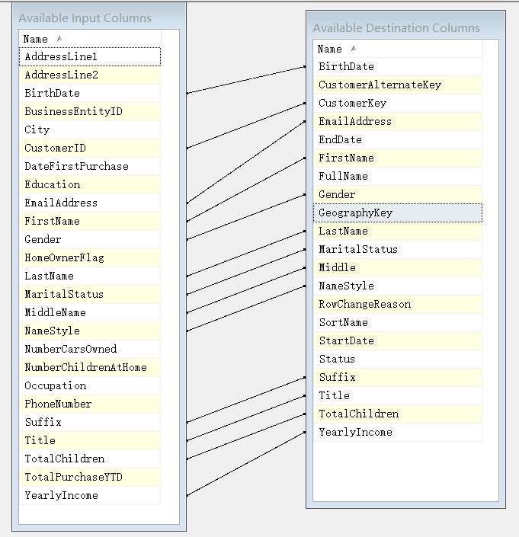
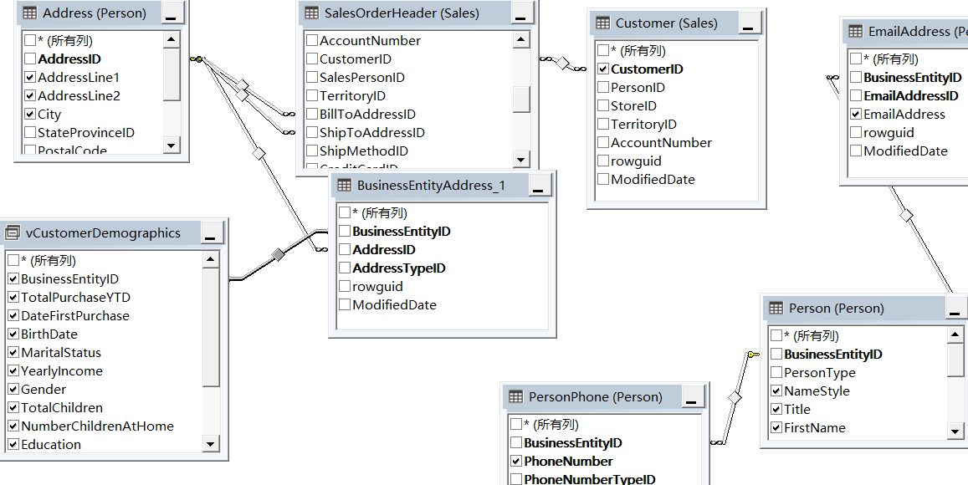
Data Preparation for Table DimCustomer
Search the missing columns of the target table and check the properties of columns between the target table and the source table.

Slide 13





ETL by SSMS and SSIS
Step 01
Create the transition table, the Customer table with the columns of CustomerID, Title, and CountryRgionName, education and occupation of a different country
The vCustomerDemographic
Copy values to columns of CustomerID, Title, and Countryregionname from tables Person.Person, Sales.Customer and [Sales].[vIndividualCustomer]
Step 03
Derive values of CustomerAlternateKey, yearlyincome, education and occupation of different country.
Step 02
Step 04
Step 05
Remove duplicate items and sort the data through CustomerID
ETL by SSIS

Slide 14
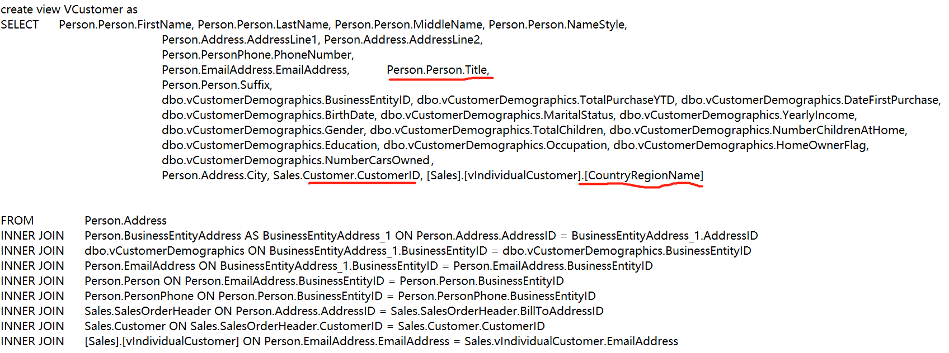
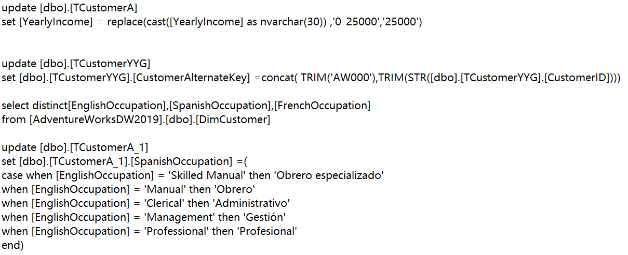
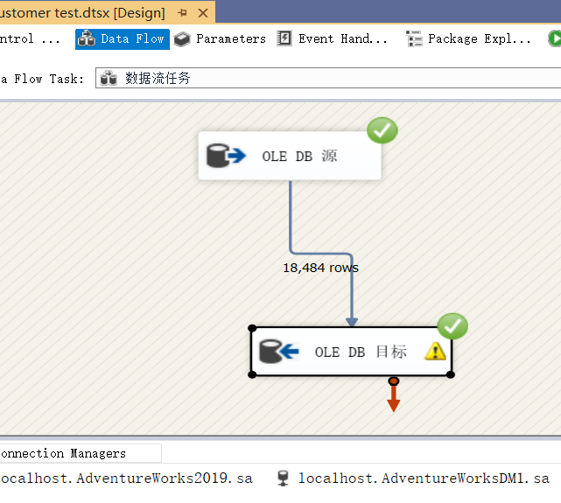
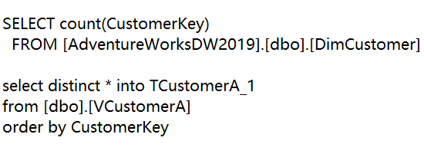
ETL by SSMS and SSIS
yearlyIncome
VCustomer
CustomerAlternateKey
SpanihOccupatison
Clean and Sort

Slide 15
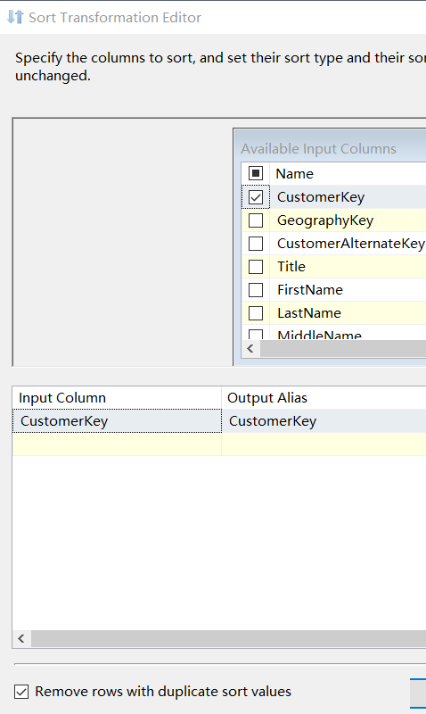
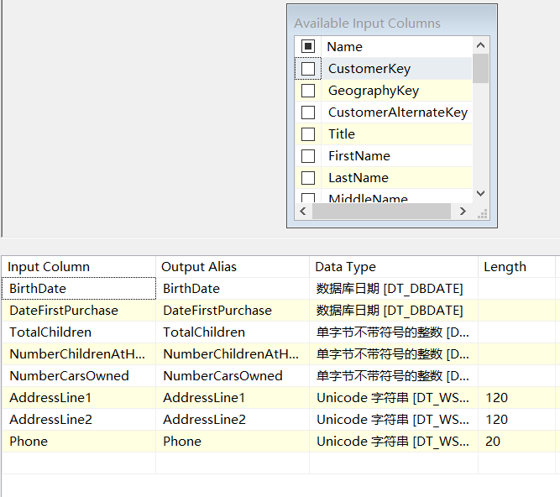
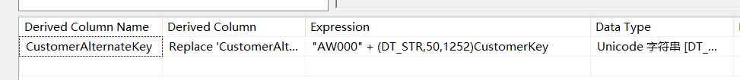
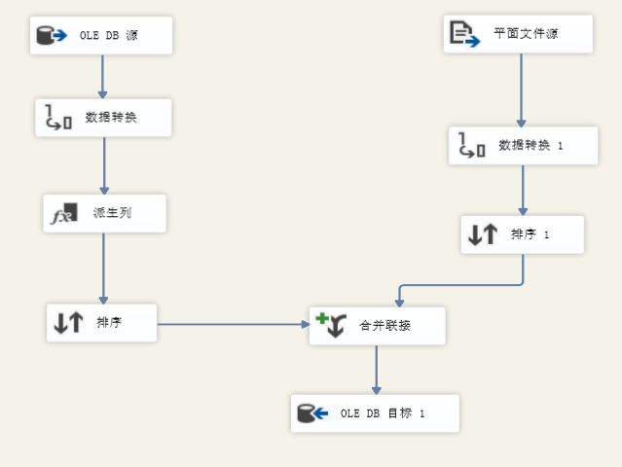
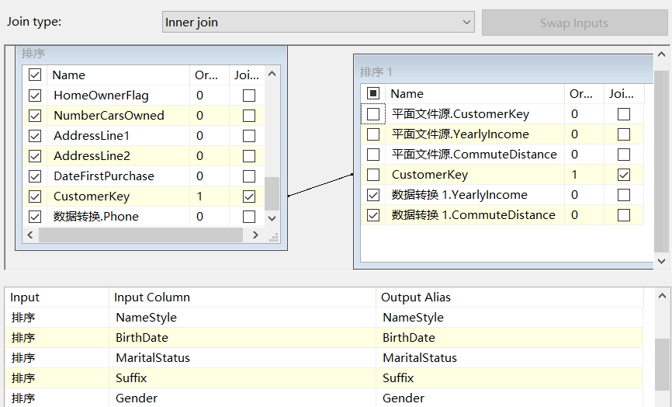
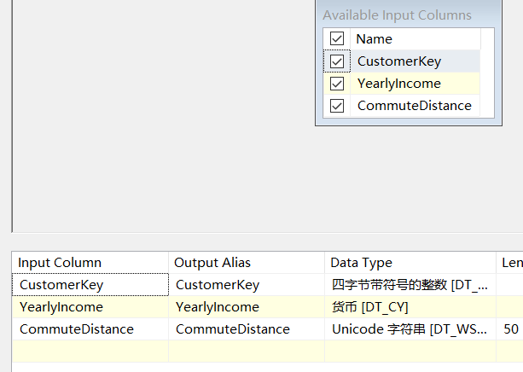
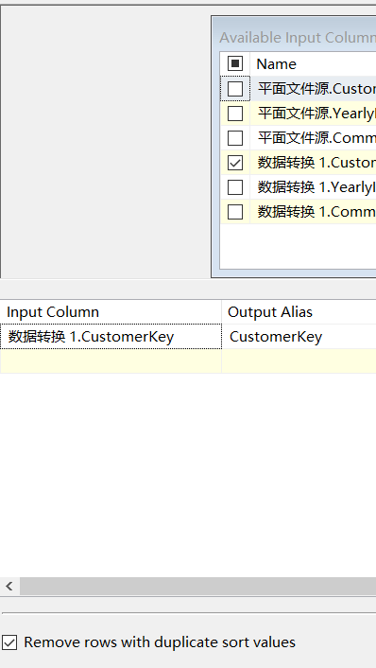
ETL basically by SSIS

Slide 16
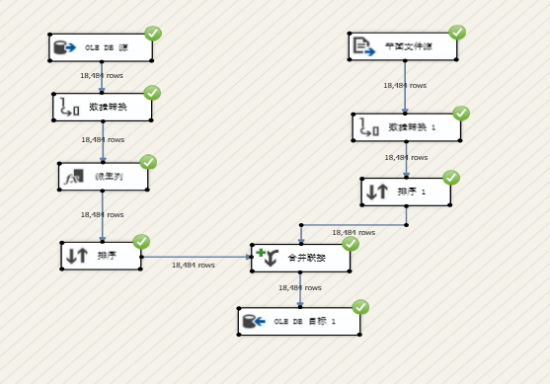
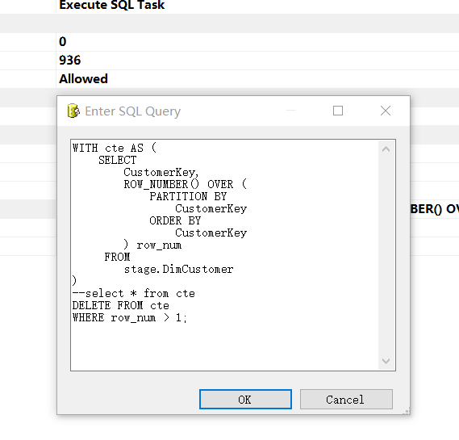
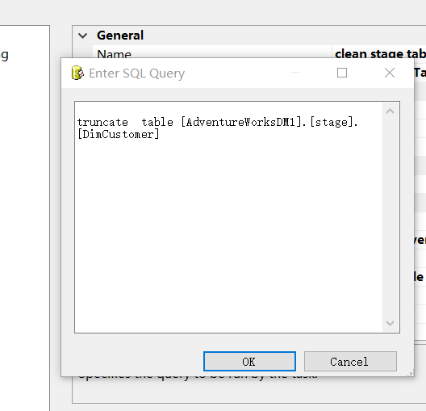
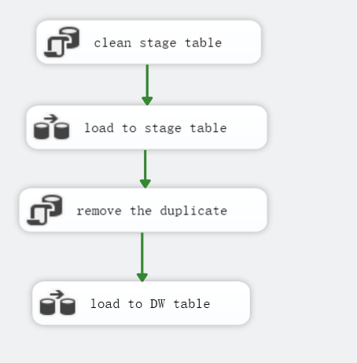
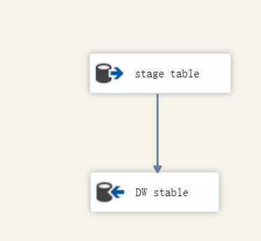
ETL basically by SSIS

Slide 17
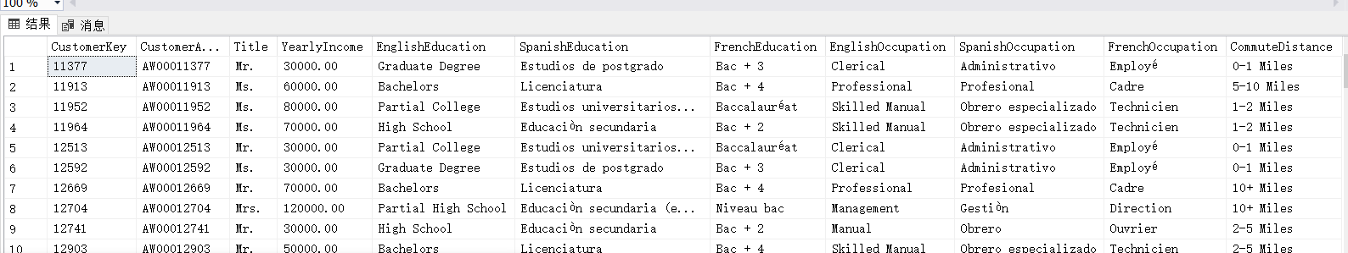
Results

Slide 18
Retail Project
ETL Implementation & Power BI
3ND meeting
2022.06.12 by David yang

Slide 19
Agenda
★ Load Date dimension data
★ Load Product dimension data
★ Review BI requirements and try to present Executive Summary with Power BI

Slide 20
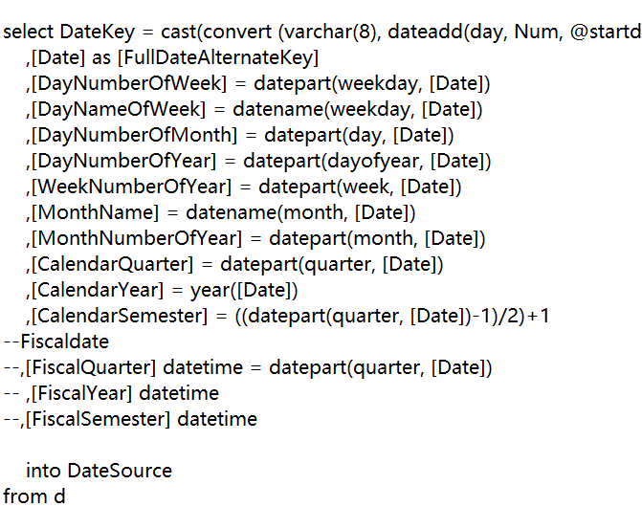
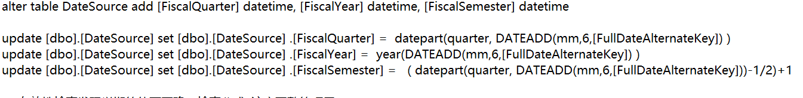
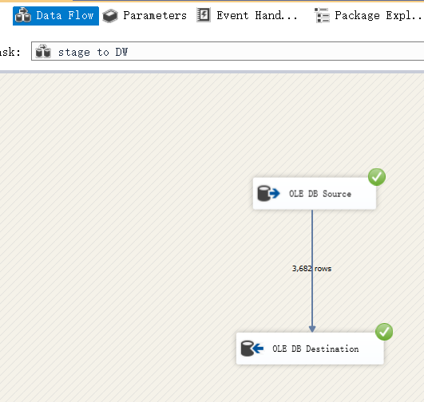
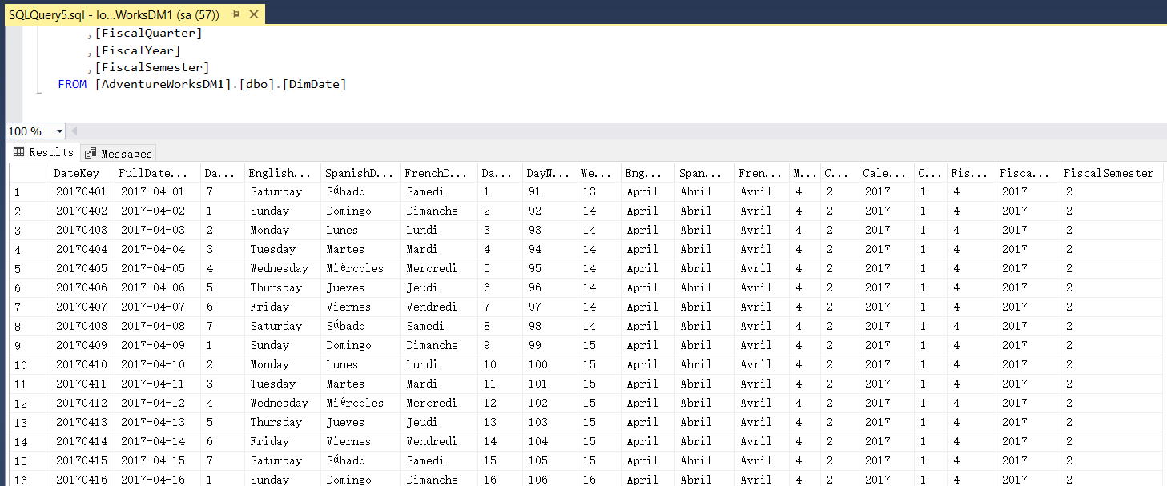
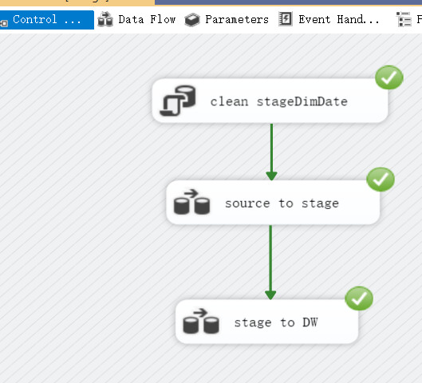
Load Date dimension data

Slide 21
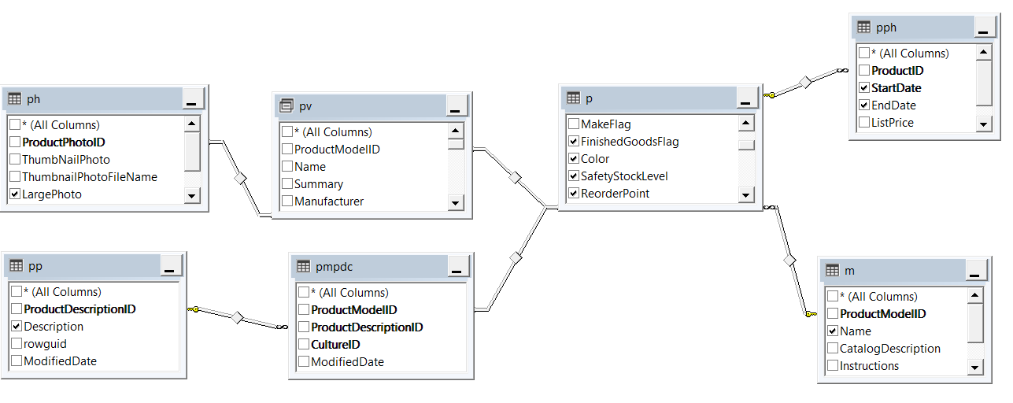
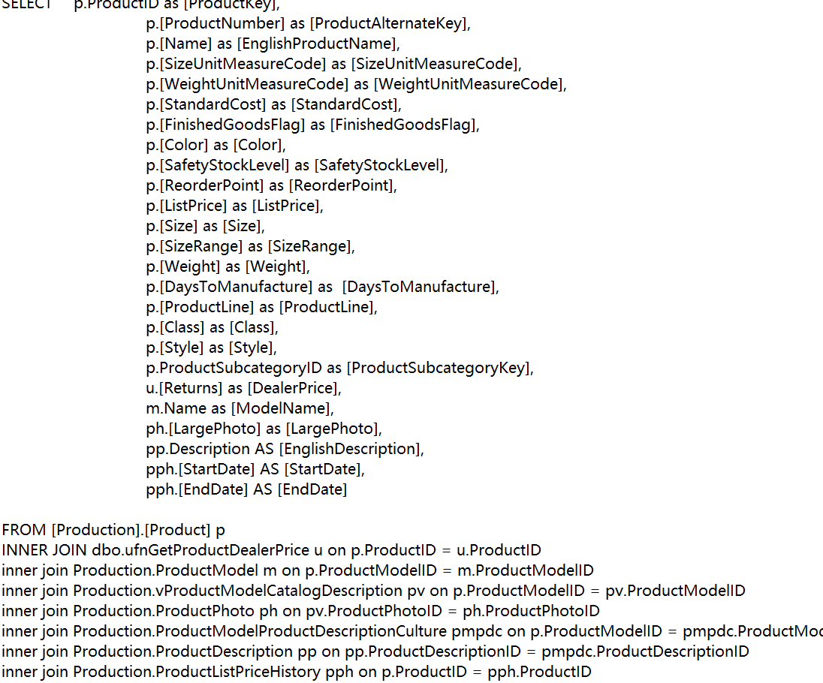
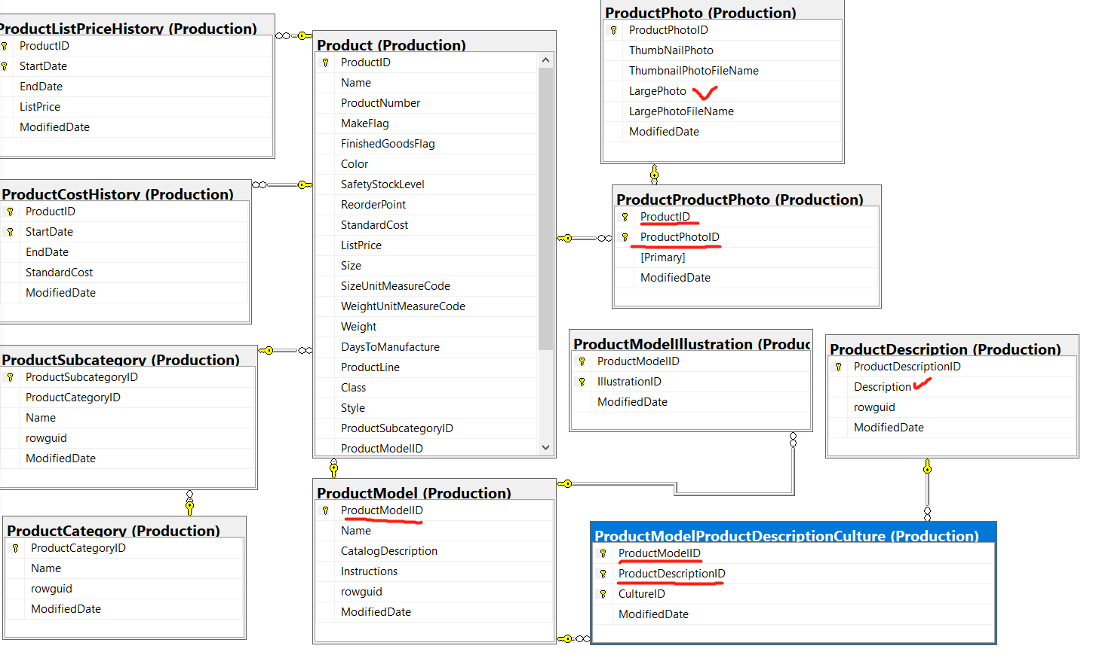
Load Product dimension data

Slide 22
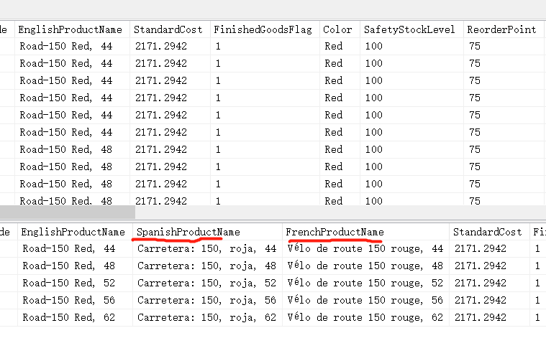
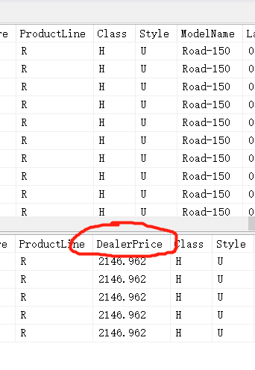
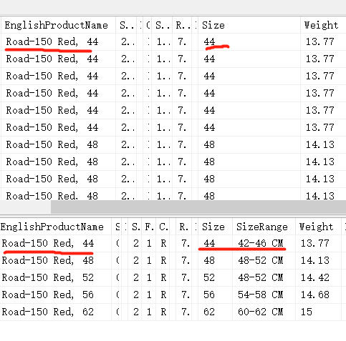
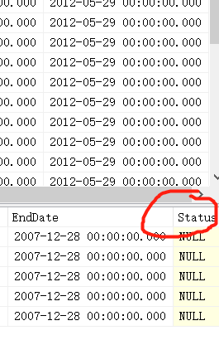
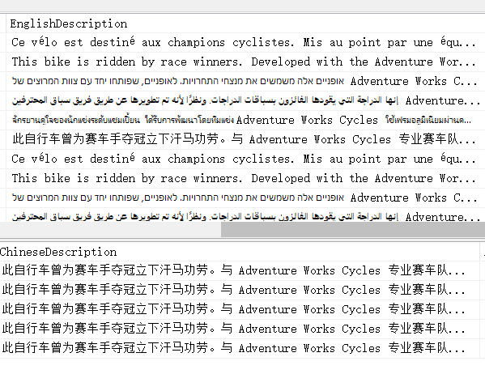
Load Product dimension data

Slide 23
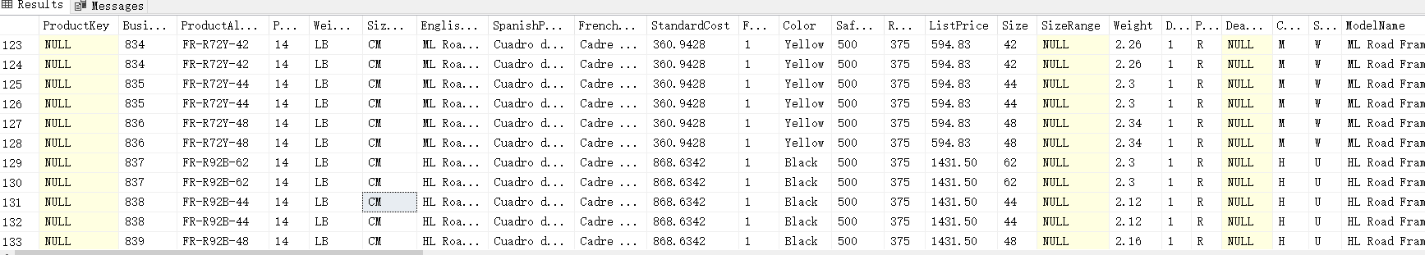
Load Product dimension data

Slide 24
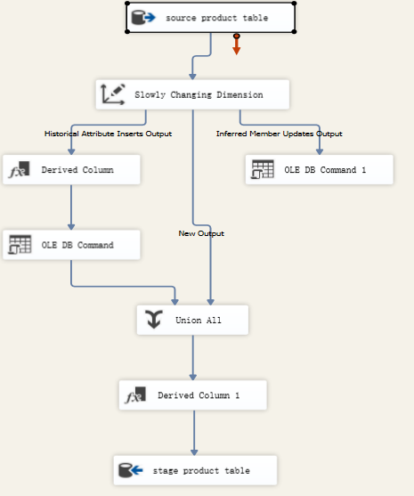
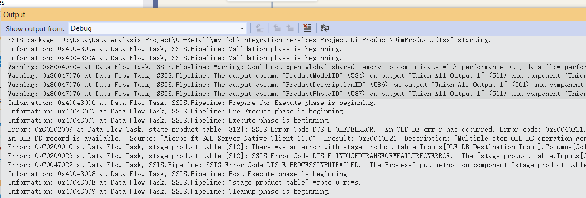
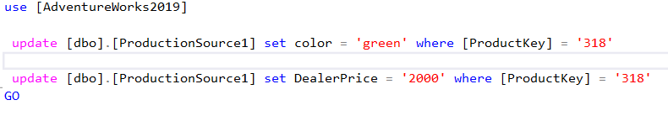
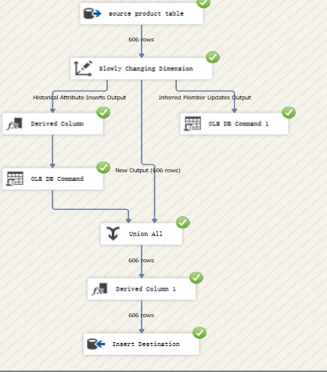
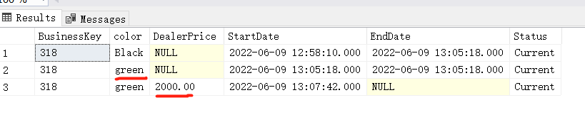
Load Product dimension data

Slide 25
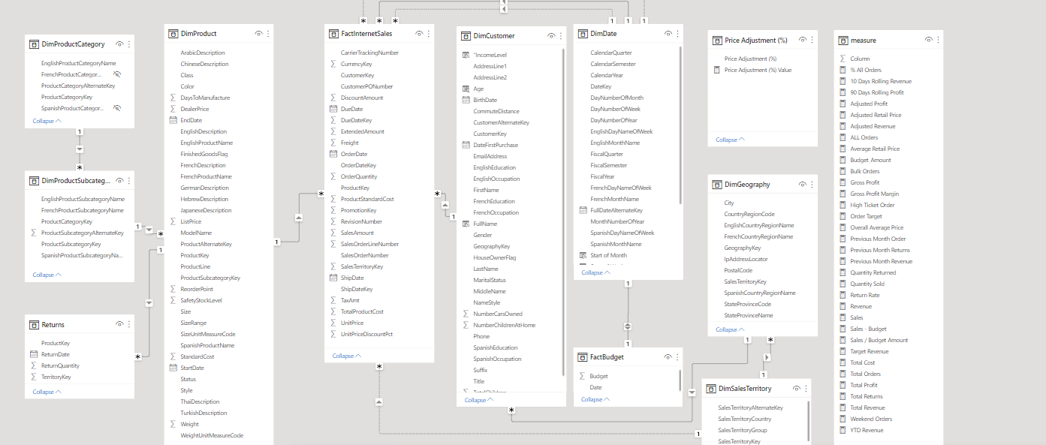
Prepare for BI inplement

Slide 26
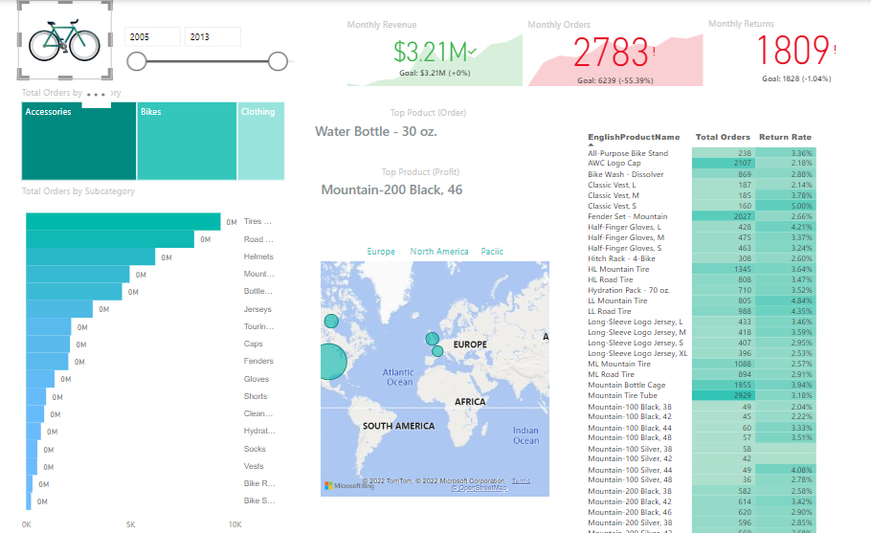
Try to BI Implementation

Slide 27
Retail Project
BI Implementation
4ND meeting
2022.06.19 by David yang

Slide 28
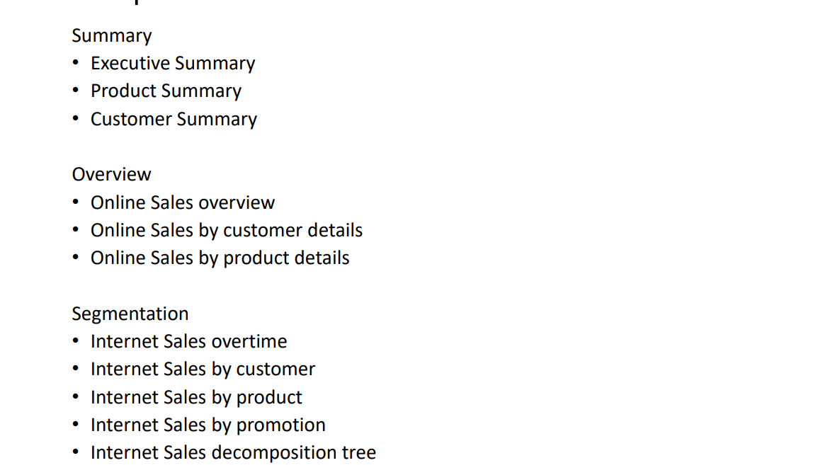

Slide 29
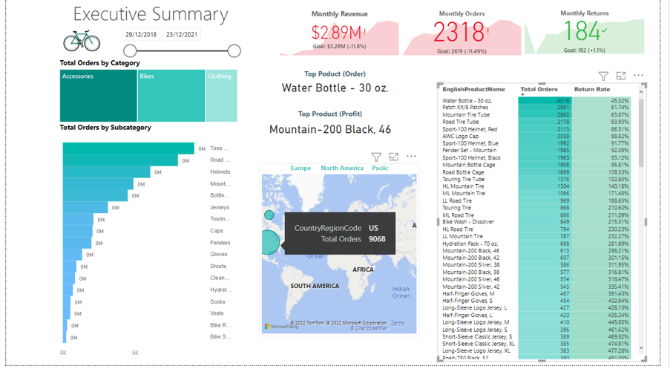

Slide 30
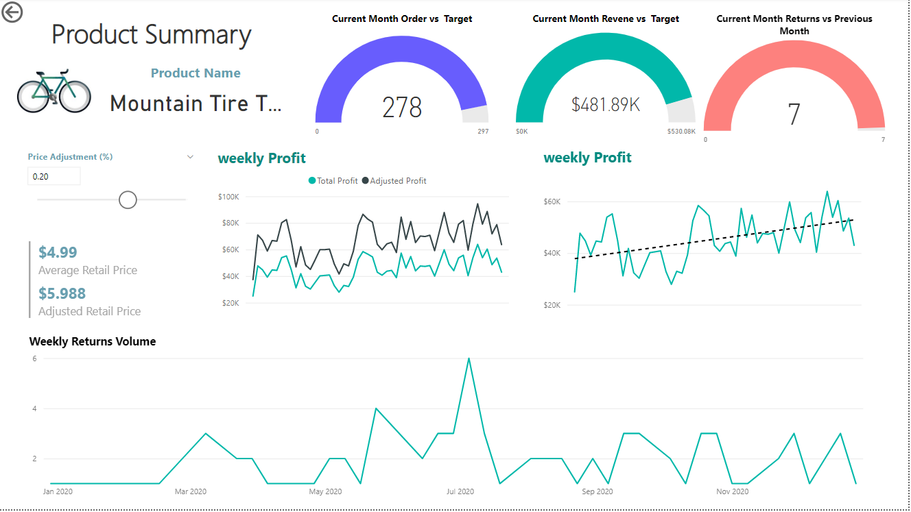

Slide 31


Slide 32


Slide 33


Slide 34


Slide 35


Slide 36


Slide 37


Slide 38


Slide 39


Slide 40
Thanks

